Slide 1
Printing Industry Market Trends and Highlights Q2 2025
RTMworld.com

Slide 2
Overview
1
Market Trends
2
Equipment Highlights
Garment Printer
Large Format Printer
On-demand Printer
Portable Label Printer
Other Highlights
3
Strategical Investment in AI
Digital Transformation
Adoption of Chinese Technology
Opinions
4

Slide 3
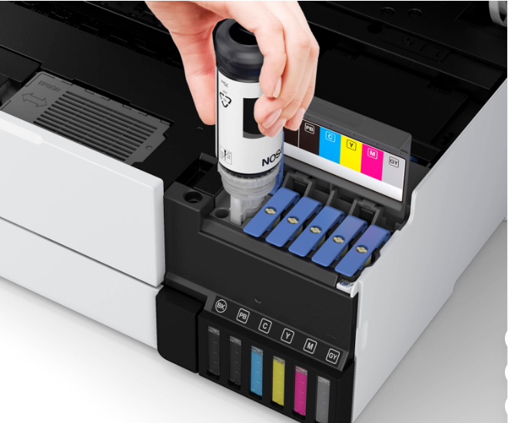
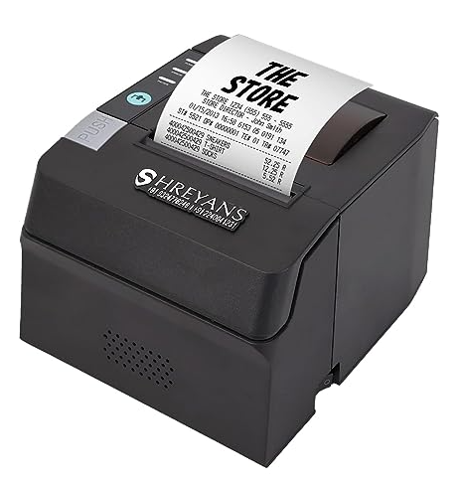
Market Trends
Ink tank printers continued to expand in Q2, 2025, marking the 4th straight quarter of year-over-year growth.
Thermal receipt printers saw significant adoption in the retail sector, increasingly used in mobile point-of-sale (mPOS) systems, especially tablet-based POS setups.
Global large-format printer sales dropped 1.4% year-on-year in 2024, only 70% of 2019 level.

Slide 4
Equipment Highlights
OEM | New Release | Highlights
Epson | SureColor G6070 | Its first wide-format direct-to-film (DTF) printer allowing users to scale up production and easily print oversized graphics
Ricoh | RICOH Ri 4000 | New garment printer designed for direct printing on garment fabrics such as T-shirts
Canon | imagePROGRAF TC-21/21M series | Compact four-color (CMYK) large format desktop printers targeting professionals in architecture, engineering, design, retail, and education.
HP | HP Latex 730/830 series | Water-based large-format printers tailored for SEMs, offering high-impact print quality, improved productivity and a sustainability edge
Roland DG | VersaOBJECT LO-640/300 series | On-demand printing solution which enables high-precision direct printing on 3D objects made from nearly any material
G&G | GG-D110 | Focusing on real-life needs, the half-inch portable label printer is designed for a whole new generation of users who value simplicity, mobility, and a better user printing experience.

Slide 5
Other Highlights
Strategical Investment in AI
Kyocera signed licensing agreement with Quadric for its Chimaera General-Purpose Neural Processing Unit (GPNPU) technology, aiming to integrate advanced AI capabilities into its future printing solutions.
Canon launched the imageFORCE C5100 and 6100, powered by Canon’s pioneering machine-learning imageFORCE technology platform.
Digital Transformation
Kyocera launched Kyocera Cloud Capture (KCC), a powerful, cloud-based document capture solution +10 cloud-ready A3 MFPs

Slide 6
Other Highlights
Adoption of Chinese Technology
Deli launched latest printer series featuring chips and processor independently developed by Loogson.
31 of Canon(China) printer models officially passed the HarmonyOS NEXT certification

Slide 7
Opinions
“Everyone assumes recycling alone can handle our global waste crisis; it can't.
The real solution is Circularity + Extended Producer Responsibility (EPR).”
—GreenForest Solutions GmbH
“In the U.S. laser MFP market during 2024, A4 gained share from A3. The shift from monochrome to color is expected to continue. Therefore, over the forecast period, A4 color laser MFPs offer the greatest opportunity for growth.”
—Geoffrey Wilbur, IDC
“Japan Post’s Digital Address system may soon become a global benchmark for combining smart logistics, digital identity, and environmental efficiency. It’s not just a new way to send mail—it’s a powerful signal of transformation.”
—Koichi Yoshizuka, founder and CEO of QRIE Ltd.

Slide 8
Stay Tuned!
For more breaking news, updates, views and opinions, visit RTMworld.com
or subscribe to our weekly enewsletter: http://eepurl.com/dgU8gH
Find us @RTMworld or rtm_world on
Contact:
Maggie.Wang@RTMworld.com

