Slide 1
Printing Industry Market Trends and Highlights Q3 2025
RTMworld.com

Slide 2

Overview
Q3 was a busy season for OEMs with numerous new product launches.
Key Themes
Innovation
Sustainability
Security
Local Manufacturing
Market Change

Slide 3
Equipment Highlights
OEM | New Release | Highlights
Epson | AM-C550Z | Heat-Free Technology
Epson | ET-2950 Series ET-3950 Series ET-4950 Series | Up to 95% printing cost savings
Epson Japan | EW-M678FT EW-M638T | Low printing costs Significantly improved printing speed and durability
Epson America | ET-3950 ET-4950 | Affordable color printing without frequent cartridge change PrecisionCore Heat-Free technology Professional-grade reliability Unique permanent printheads
Fujifilms Europe | Apeos C7070 series Apeos C3060 series Apeos C4030 series Apeos 5330 series Apeos 5570 series Apeos 3560 series | Low power consumption Reduced toner use Minized environmental impact
Fujifilm North America | Frontier DX400W | Enhanced printing output Adding two new ink colors Faster image processing/printing times Smaller overall footprint

Slide 4
Equipment Highlights
OEM | New Release | Highlights
Canon U.S.A. | imageFORCE C5100 Series imageFORCE 6100 Series | D2 Exposure Technology Print resolutions up to 4800 x 2400 dpi Sustainability
Canon U.S.A. | imageCLASS MF665Cdw imageCLASS MF663Cdw imageCLASS MF662Cdw imageCLASS LBP647Cdw imageCLASS LBP646Cdw | D2 Exposure Technology Machine-learning–powered environment recognition engine that automatically recommends optimal security settings
Canon U.S.A. | PIXMA TR7120 PIXMA TS6520 PIXMA TS4320 | Versatile solutions for everyday home and family use, Simplified routine print, scan, and copy tasks Reliable quality
Canon U.S.A. | imageFORCE 8100 Series imageFORCE C3150 imageFORCE 710 Series imageFORCE C611 Series imageFORCE 1440 Series imageFORCE C1333 Series | Enhanced security and sustainable design Consistent performance Simplified integration
Canon Japan | C5100 & 6100 series (A3) Color C3150F 8100 series C431 series(A4) | Machine-learning–powered environment recognition engine that automatically recommends optimal security settings

Slide 5
Equipment Highlights
OEM | New Release | Highlights
Brother | INKvestment Tank 580 INKvestment Tank 780 INKvestment Tank 980 INKvestment 1365 INKvestment 4355 INKvestment 4555 Work Smart 1360 Work Smart 1410 | Budget-friendly options High yield ink cartridges Refillable ink tank models A generous amount of ink included in-box
Pantum | PD-401 PD-402T PD-80 PP-110 PP-210 | New standards for efficiency, quality, and versatility in label printing
G&G | GG-HH1001C | Handheld inkjet printer that can use both water-based and quick-drying inks

Slide 6
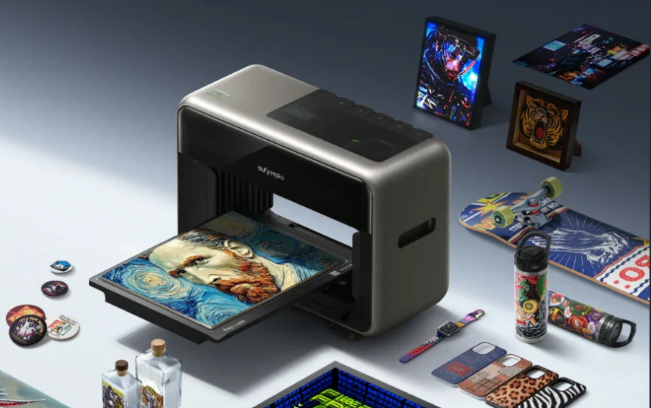
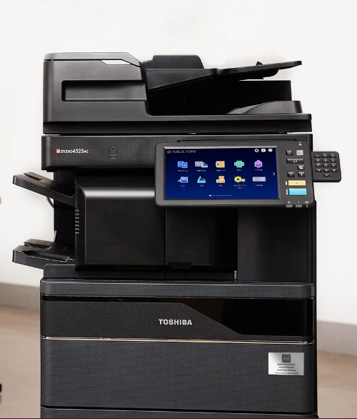
Innovation Highlights
EufyMake UV Printer E1: World’s first personal UV printer, enabling 3D texture printing.
Toshiba eTAG: First mobile, QR-enabled self-service printer registration solution.

Slide 7
Eco-friendliness & Sustainability
Eco-friendly inks market projected to grow 5.8% annually to USD 8.9B by 2035.
OEM Initiatives:
Epson: 7 new EcoTank models with high-yield, low-waste ink systems.
Canon: imageFORCE C3150 with recycled plastic components.
Fujifilm: Circular Manufacturing Center for remanufactured machines.

Slide 8

Security Concerns & Solutions
Printer security remains a critical yet overlooked risk.
Key Developments:
750+ printer models found vulnerable to botnet attacks.
Microsoft Universal Print Anywhere for secure cloud printing.
Canon’s new imageFORCE series with machine-learning-driven security recommendations.

Slide 9
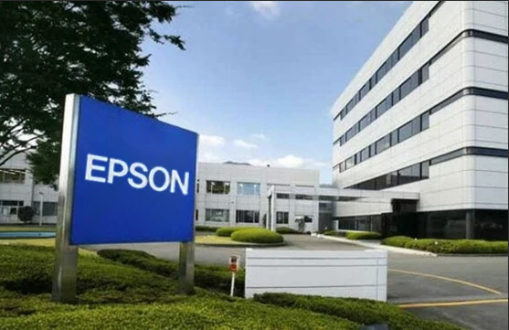
Local Manufacturing Trends
Epson opens high-capacity ink tank printer facility in India (with RIKUN Manufacturing).
A key milestone in Epson’s long-planned localization strategy

Slide 10


Market Landscape Changes
Xerox acquires Lexmark (from Ninestar & PAG Asia Capital).
Mitsubishi Chemical exits polyester resin for toner production.
ETRIA Co. Ltd. to establish new domestic production company.
Advanced Green Systems (AGS) launches toner cartridge facility in Egypt’s SCZone.

Slide 11


Opinions
“Added value in business services means fewer service interruptions and complications.”
— Ray Stasieczko
“Resilience must be designed into the supply chain.”
— Eric Zhang, CEO of Ninestar Image Tech.

Slide 12
Takeaways
Strong Q3 momentum with innovation and eco-friendly growth.
Security remains a top priority for hardware and cloud printing.
Local manufacturing and market reshuffles signal strategic shifts.

Slide 13




Stay Tuned!
For more breaking news, updates, views and opinions, visit RTMworld.com
or subscribe to our weekly enewsletter: http://eepurl.com/dgU8gH
Find us @RTMworld or rtm_world on
Contact:
Maggie.Wang@RTMworld.com

